Slide 1

“Precision. Safety. Delivered”

Slide 2
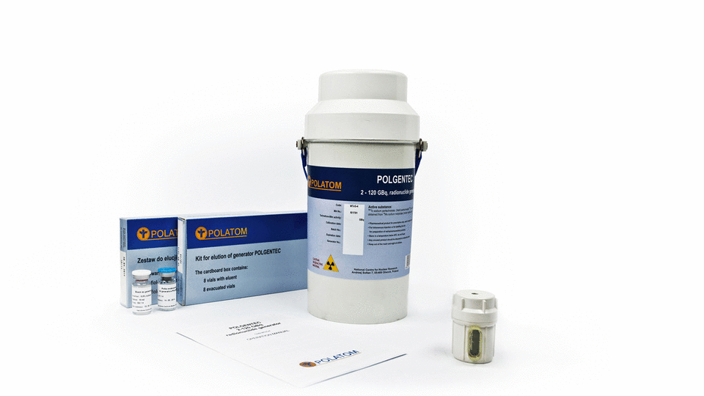
Poltechnet 99Mo / 99mTc Generator code:MTcG-04
Sodium pertechnetate (99mTc) injection is produced by means of a 99Mo/99mTc generator. 99mTc decays with the emission of gamma radiation with a mean energy of 140 keV and a half-life of 6.01 hours to 99Tc.
Indiction:
  Labelling of various kits for radiopharmaceutical.
  Thyroid and salivary gland scintigraphy.
  Location of (Meckel’s diverticulum).
  Lacrimal Duct scintigraphy

Slide 3
Features Benefits
Dry generator: less radiolysis + stable oxidation Less free radical, less contamination Better labelling efficiency, and image quality.
Eluate volume controller (from 4-8 ml), with 0.5 accuracy Help to obtain the required radioactive concentration of 99mTc in the solution.
The column is located in lead shield closed system,radiation protection,and Safe use.
The bottom end of the column is provided with a glass filter Prevent any leakage of Alumina from the column.
Expiration: 21 days from manufacturing date provides critical flexibility in emergency situations and ensures continuity of patient care during unexpected shipping delays or logistical disruptions.

Slide 4
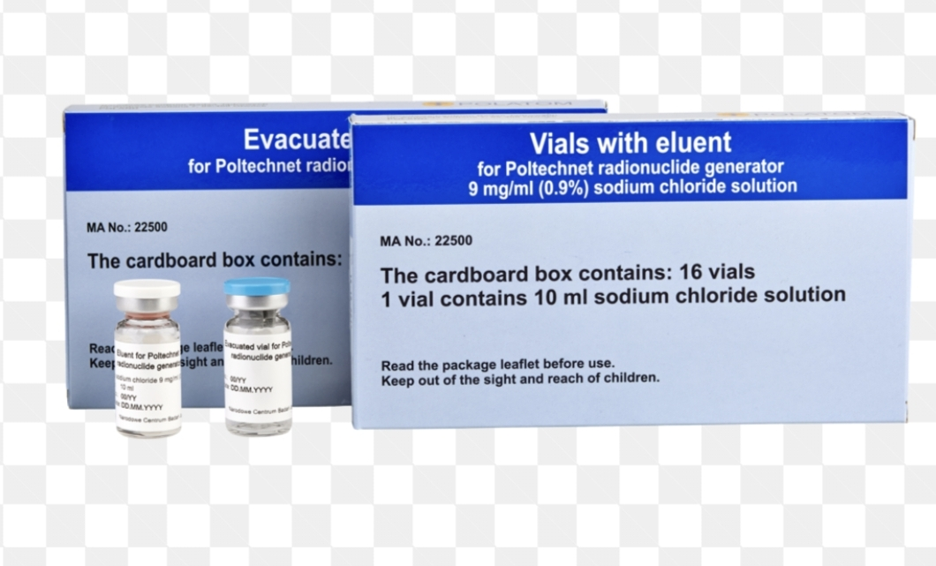
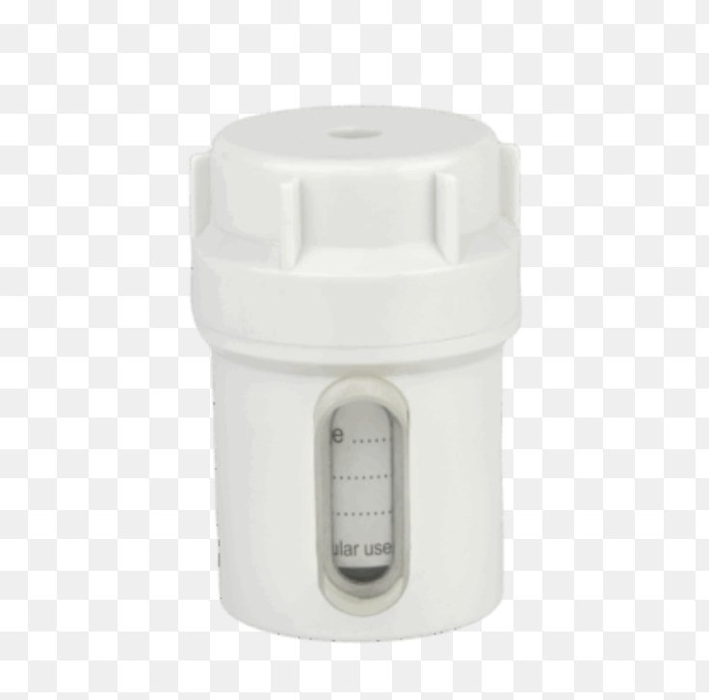
Activity And Calibration :
Poltechnet generators are manufactured on Wednesdays and Fridays within 99mTc-technetium activity range of 8–175 GBq at the production day. Within this range any activity may be prepared, according to client’s requirements and specific local regulations.
Accessories For Mo/Tc Generator
Kit for aluminium determination : Composition: Indicator strips and reagent for 10 tests
Sensitivity: 5 µg/ml
Expiration: 6 months Storage: at room temperature
Kit for elution of Poltechnet: Content:16 eluent vials of 10 ml volume containing 0.9% aqueous solution of NaCl
16 vacuum vials of 10 ml volume
Storage: < 25°C
Expiration: 12 months
Lead shield for eluate vial : Shielding container for eluate vial protects
the personnel from irradiation during the elution.
(the container is reusable and is added free of charge with the first order by a new user).

Slide 5
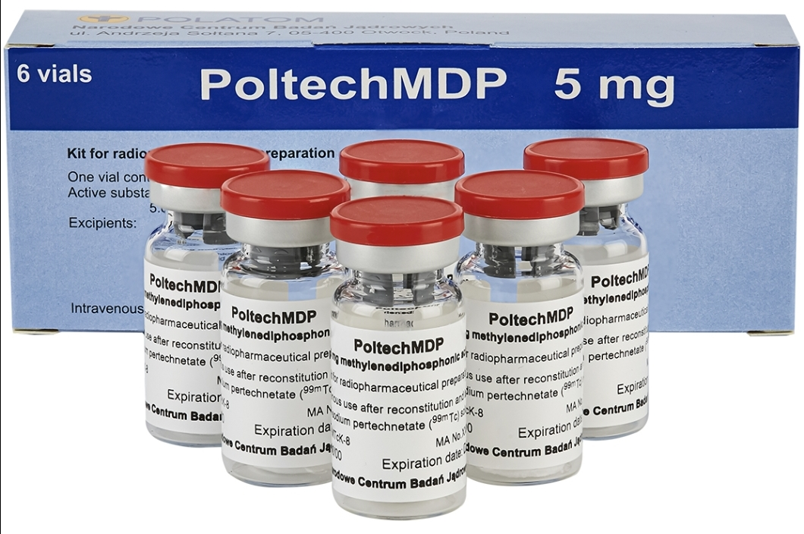
MDP PoltechMDP
kit for radiopharmaceutical preparation
Qualitative and quantitative composition:
methylenediphosphonic acid – 5 mg as sodium methylenediphosphonate – 6.25 mg.
Indications:
The radiopharmaceutical [99mTc]-MDP is intended for skeletal imaging utilizing radioactive properties of technetium ( 99mTc) and the affinity of methylenediphosphonic acid to hydroxyapatite crystals which form inorganic structure of bone .
Stability: 8 hours after completion of labelling procedure below 25 C
Expiration: The shelf life of the kit is 1 year from the day of manufacture
Storage :At temperature from 2 C to 8 C
Package: 3 or 6 vials in the cardboard box

Slide 6
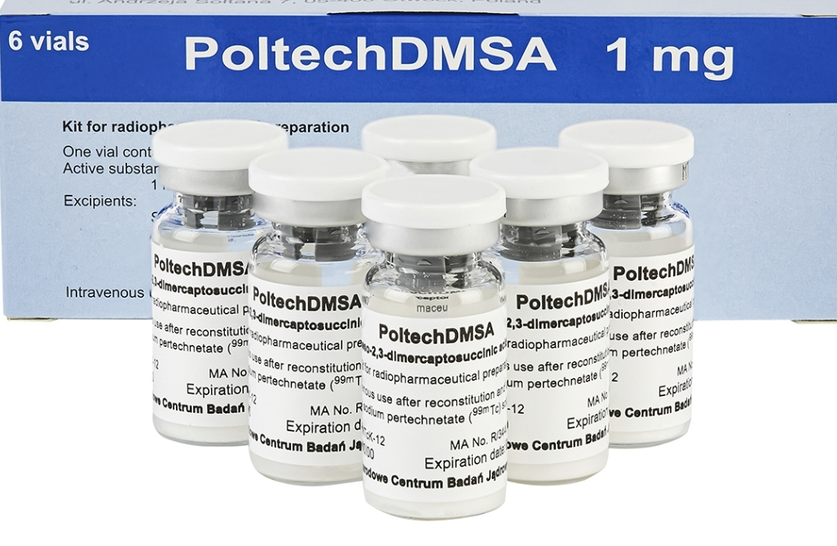
DMSA Poltech(DMSA)
kit for radiopharmaceutical preparation
Qualitative and quantitative composition: meso-2,3-dimercaptosuccinic acid (DMSA)-1mg.
Indications: renal scintigraphic examination, static renal imaging, location of kidneys, determination of functional renal mass, determination of relative individual kidney function.
Stability: 4 hours after completion of labelling procedure below 25 C.
Expiration: 6 months from the day of manufacture.
Storage:At temperature from 2C to 5C.
Package:3 or 6 vials in a cardboard box.

Slide 7
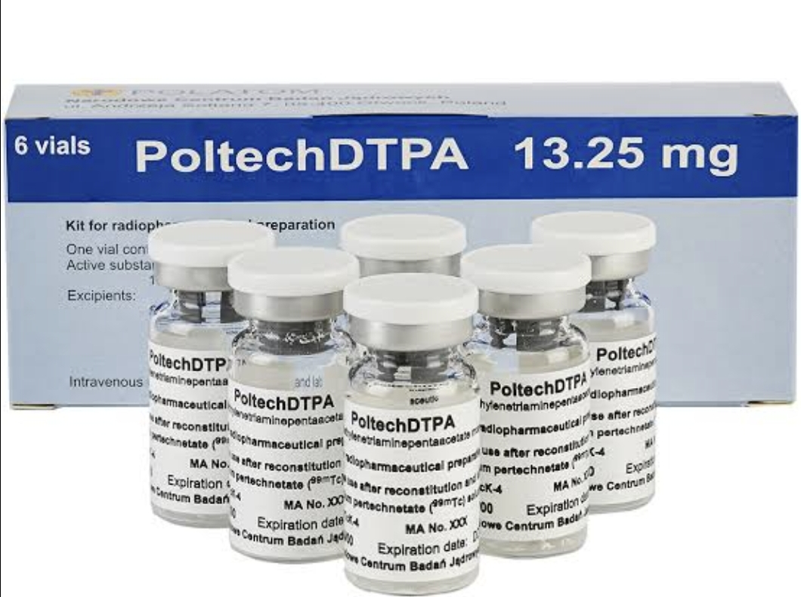
DTPA Poltech (DTPA)
kit for radiopharmaceutical preparation
Qualitative and quantitative composition:
sodium diethylenetriaminepentaacetate monohydrate (DTPA)-13.5mg.
Indication:Renal scintigraphic imaging ( dynamic renal scintigraphy for GFR measurement of each kidney, evaluation of urinary flow disorders), and the cerebral angiography and brain scanning.
Stability:6 hours after completion labelling procedure below 25C.
Expiration: 1 year from the day of manufacture.
Storage: At temperature from 2C to 8C.
Package: 3 or 6 vials in the cardboard box.

Slide 8
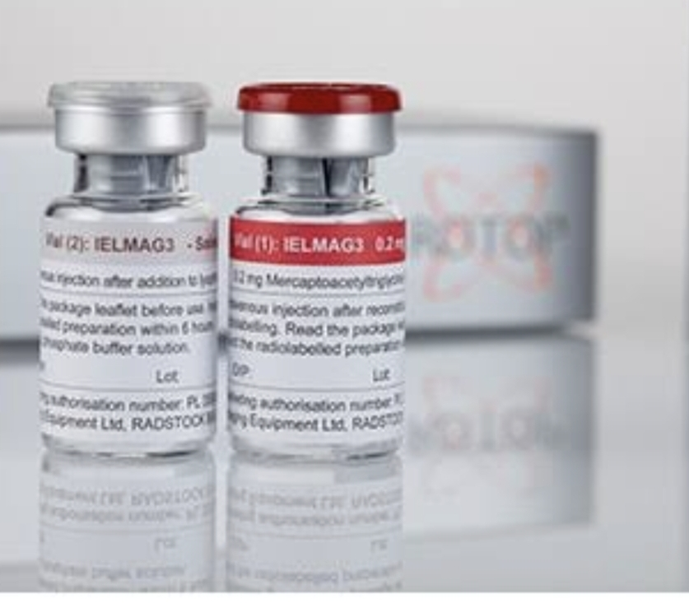
MAG-3KIT/NEPHROMAG/NON BOILING
ROTOP/Radiopharmaceutical.
Qualitative and quantitative composition: Non Boiling Mertiatide 0.20 mg
Indication: evaluation of function, morphology and perfusion of the kidneys; characterization of urinary outflow.
Stability: 8 hrs after labeiling.
Expiration: 15 months from production.
Storage: At temperature from 2C to8.
Package: 5 viale mertiatide and 5 vials.

Slide 9
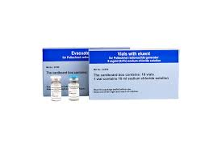
PoltechColloid, 0.17mg
kit for radiopharmaceuticals
Qualitative and quantitative composition: stannous chloride dehydrate 0.17mg
Indication: Scintigraphic diagnostics of reticuloendothelial system of liver and spleen.
Stability: 4 hours after completion of labelling procedure below 25 C.
Expiration: 1 year from the day of manufacture.
Storage: At temperature from 2 to 8 C.
Package: 3 or 6 in cardboard box.

Slide 10
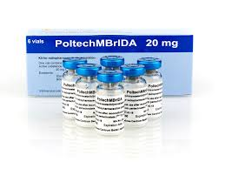
PoltechMBrIDA, 20mg
kit for radiopharmaceutical
Qualitative and quantitative composition: Mebrofenin 20 mg
Indication: Hepatobiliary tract patency and for differentiation of Jaundice.
Hepatitis , inflammation of the hepatobiliary system , Gallbladder functional disorders
Stability: 5 hours after completion of labelling procedure below 25 C
Expiration: The shelf life of the kit is 1 year from the day of manufacture
Storage: At temperature from 2 C to 8 C
Package: 3 or 6 vials in the cardboard box
.

Slide 11
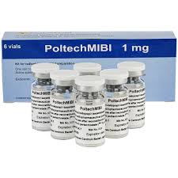
Polatech MIBI, 1 mg
Kit for radiopharmaceuticals preparation
Qualitative and quantitative composition:
Tetrakis(2-methoxy-2methylpropyl-1-isocyanide)copper(1+)tetrafluoroborate 1 mg
Indication: diagnosis of ischaemic heart disease, assessment of global ventricular function.
diagnosis of patients with recurrent or persistent hyperparathyroidism.
Stability: 12 hours after completion of labelling procedure below 25C.
Expiration: 1 year from the day of manufacture.
Storage: At temperature 2 to 8 C.
Package: 3 or 6 vials in cardboard box.

Slide 12
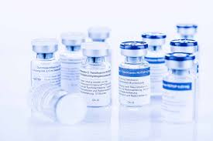
TETROFOSMIN
Qualitative and quantitative composition: Tetrofosmin ROTOP 0.23 mg (Myoview).
Indication: Myocardial perfusion imaging (MPI) to visualize heart function, assess blood flow, and diagnose coronary artery disease or heart failure.
Stability: 12 hours after labelling under room temperature.
Expiration: 1 year after production.
Storage: 2 to 5 C.
Package: 5 vials Tetofosmin vial 1.
5 vials Hydrogencarbonate vial 2.

Slide 13
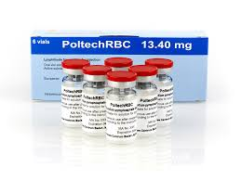
PoltechRBC (Pyrophosphate)
kit for radiopharmaceutical preparation
Qualitative and quantitative composition: Sodium pyrophosphate decahydrate 13.40mg.
Indication:
  Angiocardioscintigraphy for :
    Evaluation of ventricular ejection fraction
    Evaluation of global and regional cardiac wall motion
    Phase analysis of myocardial contractility
  Organ perfusion and vascular abnormalities imaging
  Diagnosis and localization of occult gastroenteritis bleeding
  Determination of blood volume
  Spleen scintigraphy
Stability:
3 hours after completion of labelling procedure below 25 C
Expiration:
The shelf life of the kit is 1 year from the day of manufacture
Storage:
At temperature from 2 C to 8 C
Package:
3 or 6 vials in the cardboard box

Slide 14
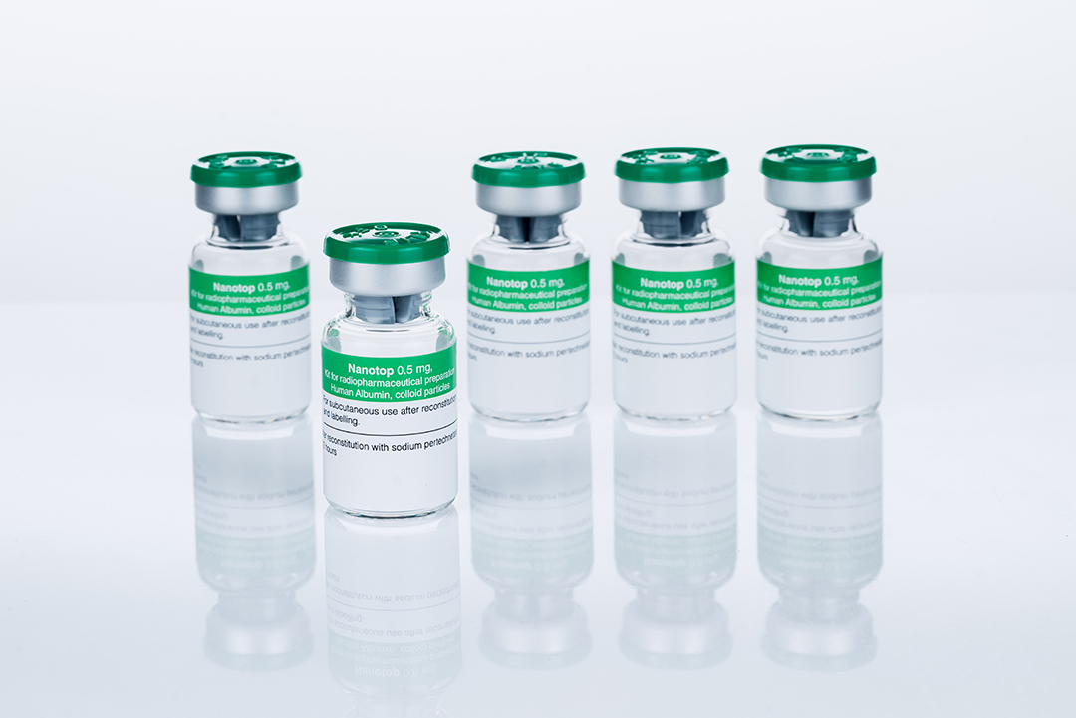
NANOTOP, 0.5mg
ROTOP, kit for Radiophamaceutical
Qualitative and quantitative composition:
human albumin, denaturated 0.5 mg more than 95 % smaller than 80 nm
Indication:
Sentinel Node detection in malignant melanoma and breast cancer, lymphatic scanning, and bone marrow scanning.
Stability:
6 hrs after labelling at room temperature.
Expiration: 24 months after production.
Storage: below 25 C.
Package: 5 vials.

Slide 15
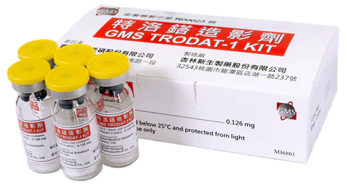
TroDAT-1(GMS)
Qualitative and quantitative composition: Each 10 ml-vial contains a pre-dispensed mixture of 126 μg TRODAT-1·3HCl. No bacteriostatic preservative is present.
Indications: Imaging of dopamine transporters located in the dopaminergic presynaptic neuron terminals in the striatum.
Clinical Utility of Tc-TroDAT-1 :
Tc-99m-TRODAT-1 binds to the dopamine transporters (DAT) located on the presynaptic nerve endings in striatum. When neuronal degeneration is present, the numbers of DAT are significantly reduced. By detecting the binding of Tc-99m-TRODAT-1 to the dopamine Transporters, physician will have a clear visualization of dopamine transporter integrity and consequently an accurate diagnosis of disease..
Reported Clinical Application:
Clinically uncertain Parkinsonian Syndromes.
To differentiate essential tremor from parkinson ian syndromes related to idiopatic parkinson’s disease , multiple system Atrophy and Progressive Supranuclear Palsy .
Storage: below 30°C and protected from light.
Expiration: 4 hours.
Package: 5 or 30 vials .

Slide 16
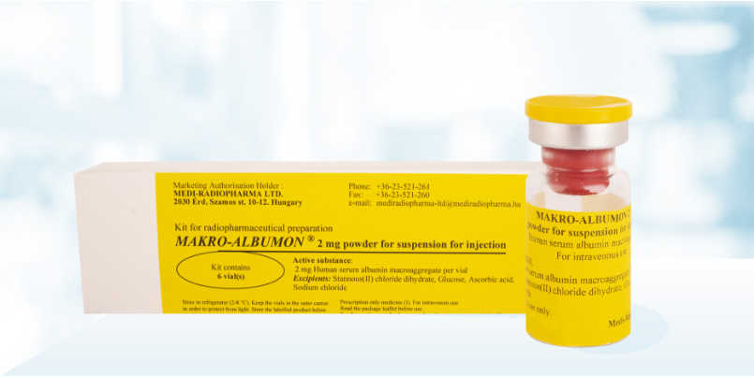
MAA Radiopharma
Bacon-Radiopharmaceuticals
Qualitative and quantitative composition:
Albumin Macroaggregated 2.0 mg Stannous chloride dihydrate 0.2 mg Sodium acetate 80 mg.
Indication:
perfusion scintigraphy of the lungs for:
pulmonary embolism, pulmonary infarction, chronic obstructive pulmonary diseases, regional pulmonary ventilation disorders, emphysema .
Stability:
6 hrs after labelling.
Expiration:
9 months after production.
Storage: 2 - 8 °C
Package: 5 vials.

Slide 17
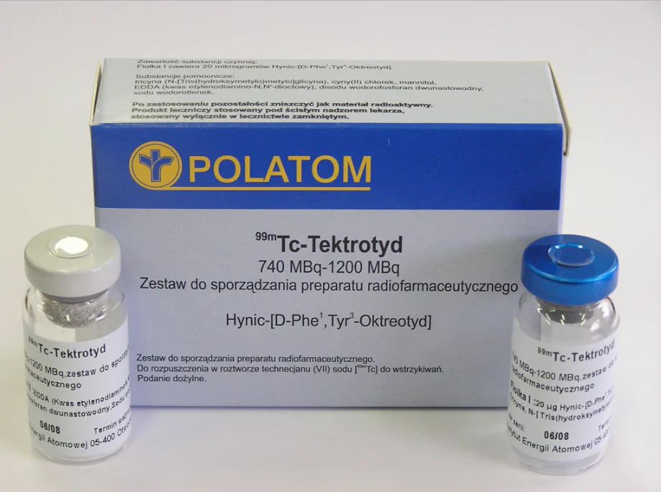
Tc-Tecktroyd, 16mgr
Kit for radiopharmaceuticals preparation
Qualitative and quantitative composition:
HYNIC-P[D-Phe,Tyr-Octreotide] TFA, 16 mcg.
Indication:
Gastro-entero-pancreatic neuroendocrine tumours.
Pituitary adenomas.
Tumours originating in a sympathetic system, pheochromocytoma, paraganglioma, neuroblastoma.
Medullary thyroid carcinoma.
Works by targeting somatostain receptora(SSTRs).
Stability: 6 hours after completion of labelling procedure below 25 C.
Expiration: The shelf life of the kit is 1 year from the day of manufacture
Storage:2 to 8 C
Package:
1set of 2 vials
in the cardboard
box.

Slide 18
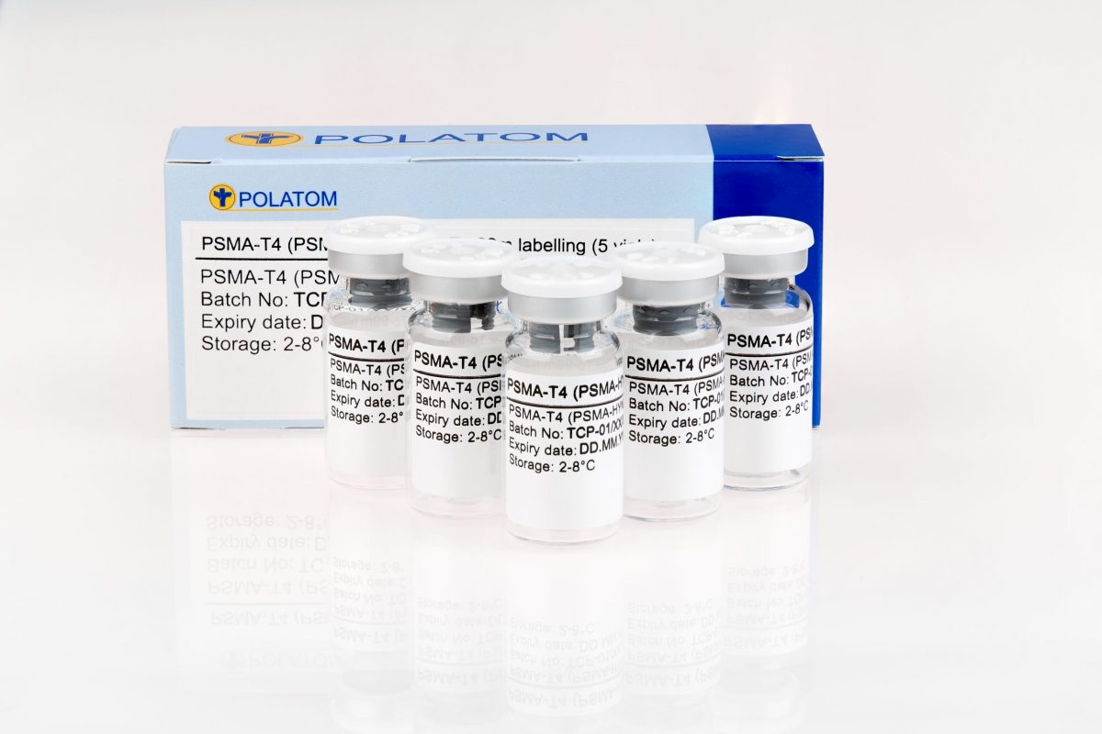
Tc-PSMA, 20mgr
Kit for radiopharmaceuticals preparation.
Qualitative and quantitative composition: PSMA -T4, 20 µg.
Indication:Prostate-specific membrane antigen (PSMA) show great potential as radioisotope carriers for the diagnosis of patients with metastatic PCa. PSMA is expressed in most types of prostate cancer, and its expression is increased in poorly differentiated, metastatic, and hormone-refractory cancers.
Maximum activity: 1000 to 1500 Mbq
Stability: 4 hours after labelling.
Expiration: 1 year from production.
Storage: 2 to 5 C.
Package: 5 vials in
cardboard box.

Slide 19
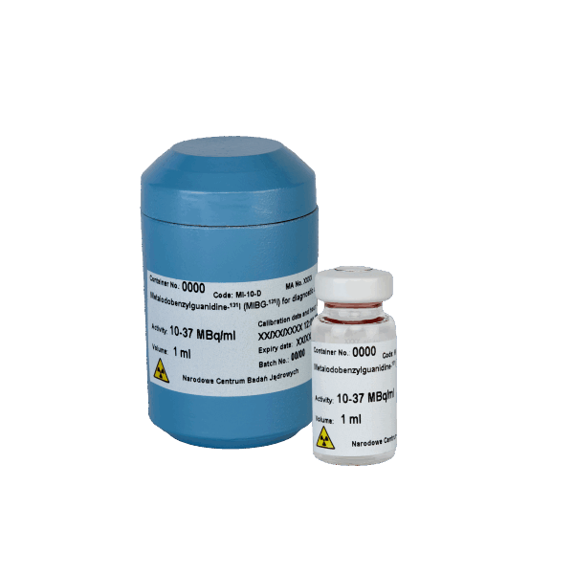
MIBG-131I – diagnostic solution for injection
Qualitative and quantitative:
Meta-Iodo[131I]benzylguanidine sulphate, 10-37 MBq/ml.
Indications: Isotope diagnostics (detection, localization, staging, treatment monitoring) of neuroendocrine tumors(pheochromocytoma, neuroblastoma, carcinoid tumors, medullary thyroid carcinoma).
Expiration : 9 days from the manufacturing date.
Storage: at [-15 C] Protected from light, and after defrosting store below 25C for up to 4 hours. Transport in dry ice.
Package: supplied in 10 ml glass vials, with a possibility of drawing multidoses in an aseptic way.

Slide 20

MIBG-131I – therapeutic solution for injection
Qualitative and quantitative composition:
Meta-Iodo[131I]benzylguanidine sulphate, 370-7400 MBq/ml.
Indication:
Radiation therapy of tumour-tissue that is capable of retaining iobenguane.
These are tumours arising from cells originating embryologically from the neural crest: pheochromocytomas, neuroblastomas, carcinoids and medullary carcinomas of the thyroid gland (MCT).
Expiration : 4 days from the manufacturing date.
Storage: at [-15 C] Protected from light, and after defrosting store below 25C for up to 2 hours. Transport in dry ice.
Package: supplied in 10 ml glass vials, with a possibility of drawing multidoses in an aseptic way.

Slide 21
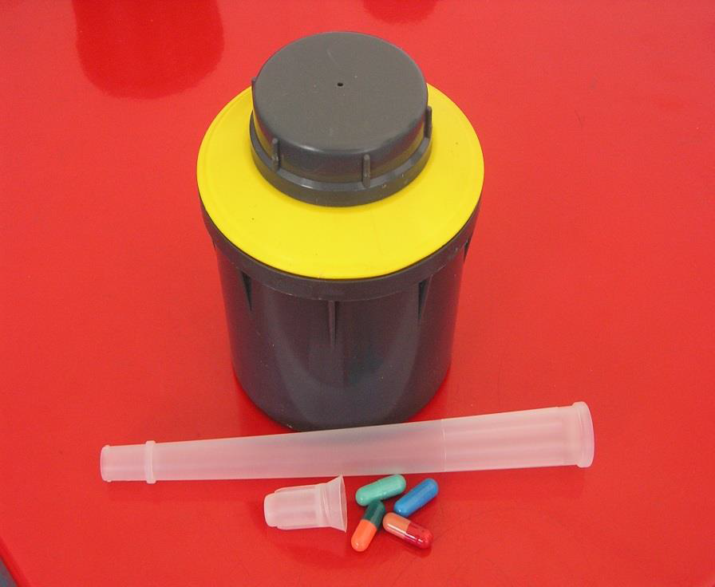
Sodium iodide Na131I – diagnostic capsules
Hard capsules,1-37MBq
Qualitative and quantitative composition:
Sodium iodide (Na131I) [1-37 MBq]
Indication:
Thyroid function disorders (hyperthyroidism and hypothyroidism), evaluation of thyroid tissue location (including ectopy), its size, shape, functional analysis of focal lesions: “cold” (not trapping iodine), “warm” (trapping iodine at a similar extent to normal thyroid parenchyma), “hot” (trapping iodine at a higher extent than normal thyroid parenchyma) nodules. It is the basic radioisotope in the diagnosis of metastatic lesions of differentiated thyroid cancers (following the surgical removal of the thyroid or radioisotope ablation).
Expiration: 21 days from the production date
Storage: At temperature below 25 C
Package: capsules for diagnostic use, are supplied in two types of immediate packages:
1-Capsules with activity of 1-4 MBq
in the polypropylene vials, sealed with the
polyethylene stoppers.
2-Capsules, with activity of 1-37 MBq
in the polypropylene vials,
sealed with stopper containing
iodine absorber and placed
in shielding lead containers.
Each container is accompanied by a separate applicator for capsule administration.

Slide 22
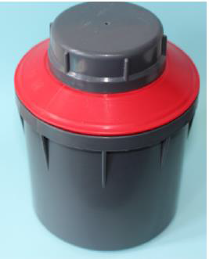
Sodium iodide Na131I – Therapeutic capsules
Hard Capsules, 37-7400MBq
Qualitative and quantitative composition:
Single hard capsule contains sodium iodide (131I) in the radioactivity range [37-7400 MBq].
Indication:
Thyroid nodular goitre, hyperthyroidism in the Graves-Basedow’s disease, autonomic nodule and the toxic multinodular goitre. It is used for the thyroid residue ablation after surgery of differentiated thyroid tumours and in the treatment of iodine-accumulating metastases.
Expiration:21 days from the production date
Storage: At temperature below 25 C.
Package:The polypropylene vial closed with a polypropylene stopper containing iodine absorber and placed in a shielding lead container. Every vial contains a single capsule.
Each container is accompanied
by a separate polypropylene
applicator for capsule
administration.

Slide 23
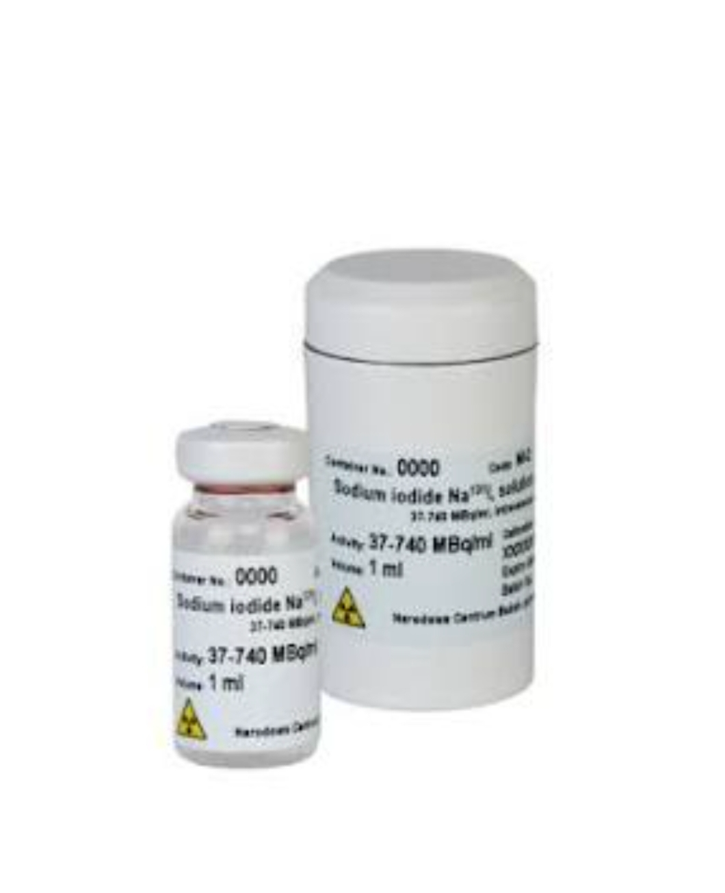
SODIUM IODINE NA131I
SOLUTION FOR INJECTION
Qualitative and quantitative composition:Sodium iodide (Na131I) [37-7400 MBq/ml]
Indication:
Hyperthyroidism: Used for an overactive thyroid, including conditions like Graves' disease and toxic nodular goiter.
Thyroid Carcinoma: Specifically for treating well-differentiated thyroid cancers (like papillary and follicular) and for the ablation (removal) of remaining thyroid tissue after surgery.
Thyroid Metastases: Used to target thyroid cancer cells that have spread to other parts of the body, such as the lungs or bones.
Calibration : 7 days
Radiochemical / Radionuclidic purity:
≥ 97% / ≥ 99.9%
Expiration:28 days from the production date
Storage:At temperature<25C.
Package:10 ml glass vials, closed
with rubber stoppers and aluminum
caps and placed inside a lead
container.

Slide 24
POLATOM & ROTOP KEY PRODUCTS AND ADVANTAGES
Generator
Dry Column Technology: High labeling efficiency
Shelf Life: 21 days expiry
Package: 16 evacuated saline vials included
Additional Feature: Tc-99m concentration control adaptor
Iodine Capsules
Color-Coded Capsules: Easy identification
Calibration: Up to 7 days
Diagnostic Activity: Less than 1 mCi
Accessories: Included in package
Nanocolloid
Preparation: No boiling required
Composition: Human serum albumin
Shelf Life: 24 months
Particle Size: < 80 nm
MAG3
Preparation: No boiling required
Shelf Life: 15 months
Operational Benefit: Simplified preparation process
T
Tektrotyd
Labeling Efficiency: Higher Tc-99m labeling
Image Quality: High-resolution imaging
Availability: Tc base always in stock
Workflow Advantage: No collimator exchange needed
Tetrofosmin
Imaging Protocol: Faster imaging (2 hrs instead of 6 hrs)
Clinical Benefit: Lower liver uptake
Preparation: No boiling required
MIBG I-131
Shelf Life: Extended to 9 days
Operational Benefit: Improved logistics and usability

Slide 25
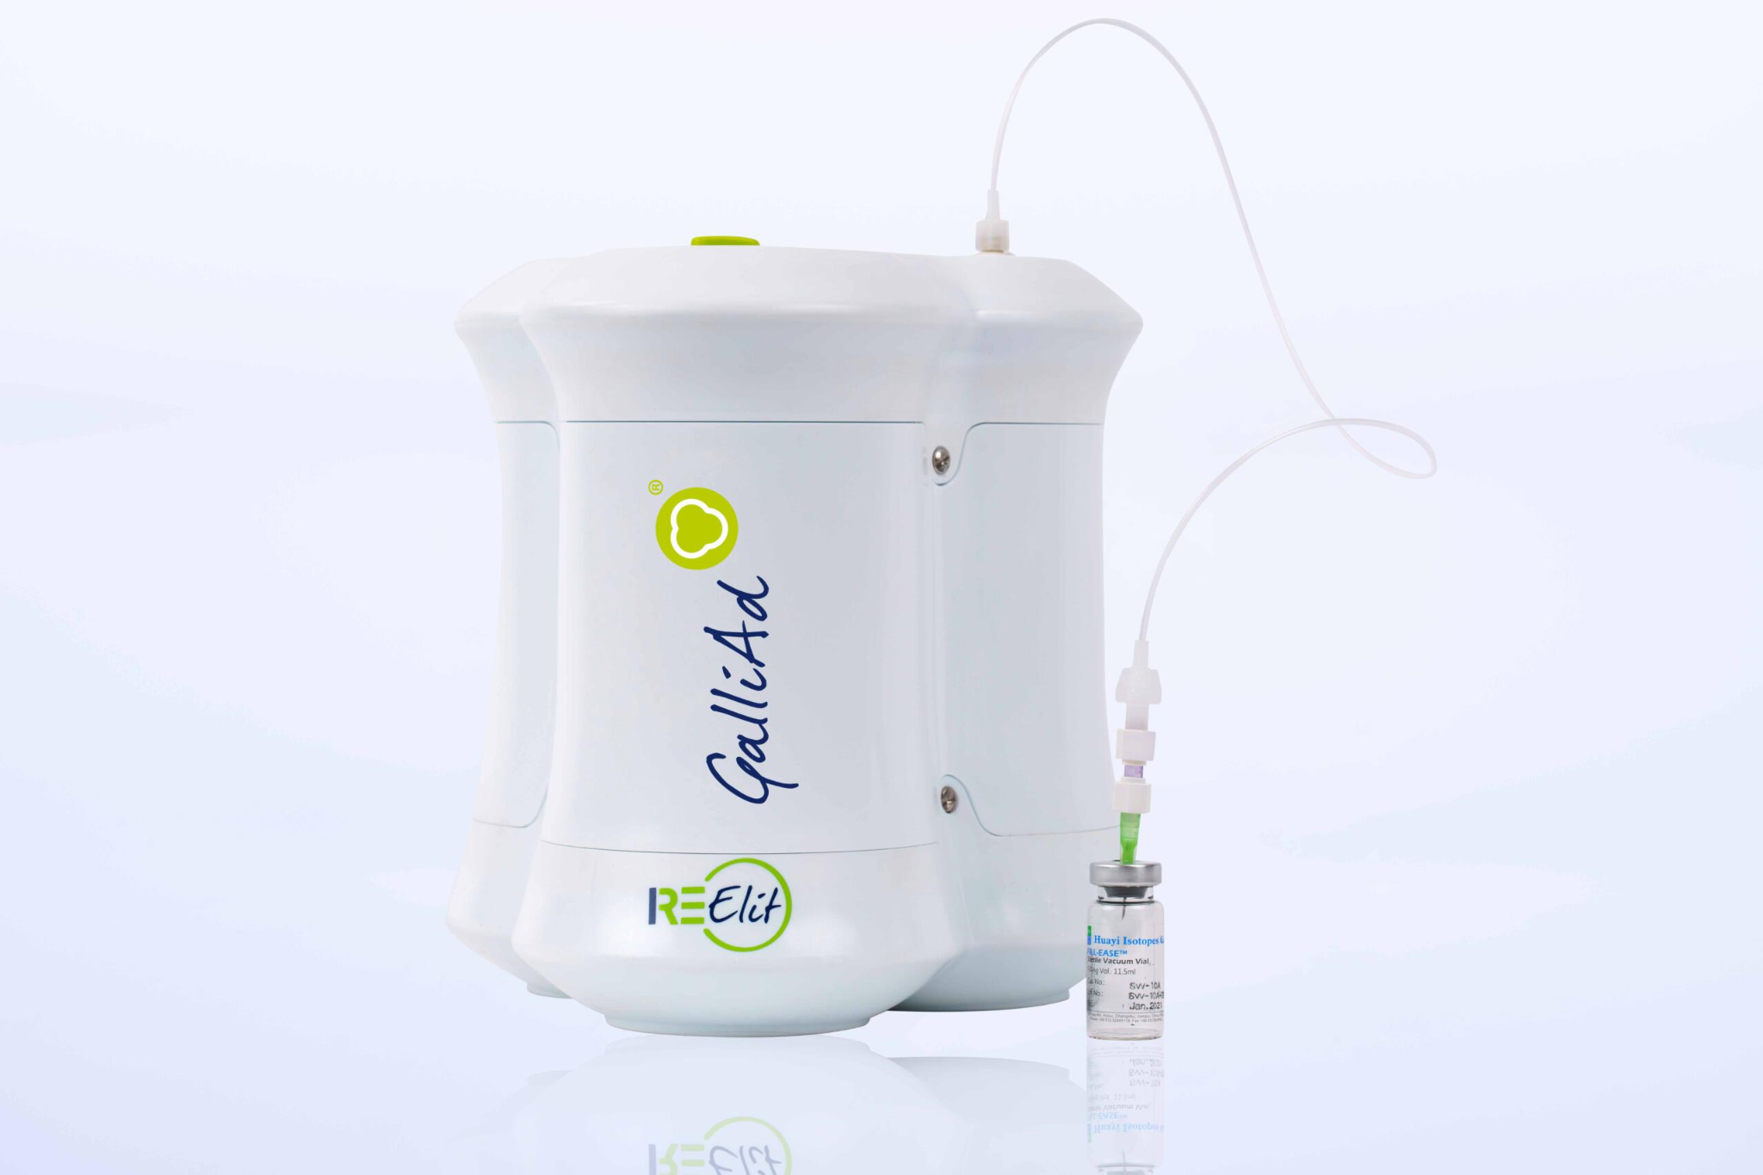
IRE ELiT Galli Ad(Gallium-68 generator)
IRE ELiT has significantly expanded its production capacity, introducing high-activity generators to meet growing global demand.
Stable and Reliable supply: ensured that the market is now adequately served without any disruptions, facilitating the continued use of Ga-68 in medical imaging worldwide.
Perfectly designed for cold-kit-based method: similar to Tc-99m generator.
The Galli Ad generator is the only generator which works by suction (via vacuum application) as against by positive pressure
Galli Ad is manufactured and tested under cGMP compliance, adhering to stringent regulatory standards to ensure safety.

Slide 26
Specifications of Generator
CHEMICAL FORM : 68GaCl3 in 0.1M HCl (Gallium Chloride solution)
AVAILABLE ACTIVITY:20-30-40-50 mCi
(0.74-1.11-1.48-1.85 GBq)
ELUENT: Sterile 0.1 M HCl
ELUTION VOLUME: 1.1 mL
ELUTION TIME: 3 min.
ELUTION YIELD > 70% at release, > 55% end of life
TIME BETWEEN TWO ELUTIONS: 3 hours.
SHELF LIFE: Min 450 elutions or 1 year.
DIMENSIONS : 220 mm (W) * 210 mm (D) * 230 mm (H).WEIGHT: 16.5 kg.
Services:
Lead Time:8 weeks maximum.
Free dismantling of expired generator.
Initial training and Technical assistance when needed.
Consumables: Sterile Tubing, Male Male Luer-Lock C connector, Sterile Needles 0.8*16MM and 10ML Sterile Evacuated Vials.
SmPC available here: https://www.ire.eu/en/our-activities/ire-elit/galli-ad

Slide 27
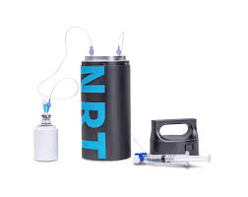
GalliatorTM Gallium-68 Generator *
Easy Operation, High Elution Yield NRT Proprietary Technology.
Optimized Titanium Dioxide Matrix
The European Pharmacopoeia Is Followed
First Elution Yield ≥ 80%
Long-Term Elution Yield ≥ 60%
Customized Specifications Available 30-70 mCi
ELUTION VOLUME: 5ml
ELUTION SPEED: 2.5ml/min.
ELUENT: 0.1 mol/L hydrochloric acid
SHELF LIFE: Min 450 elutions or 1 year.
DIMENSIONS : 108 mm * 266 mm
WEIGHT: 14 kg.

Slide 28
PEPTIDES FOR Ga-68
PSMA kit for 68Ga labelling
Code: PMA-01
Composition: PSMA-11: 20 μg /vial
Sodium acetate: 60 mg/vial
Primary packaging: 10 mL glass vial sealed with rubber closure
and flip-off cap
Storage conditions: 15-25oC
Shelf life: 12 months
Features: sterile, endotoxin free, freeze-dried solid
Purpose: for 68Ga labelling (68GaCl3 in 0.05 or 0.1M HCl
DOTATATE SA 40 μg kit for direct 68Ga radiolabelling
Code: DOT-07
Composition: DOTATATE trifluoroacetate: 40 μg /vial
Sodium acetate: 35 mg/vial
Primary packaging: 10 mL glass vial sealed with rubber closure
and flip-off cap
Storage conditions: 15-25oC
Shelf life: 12 months
Features: sterile, endotoxin free, freeze-dried solid
Purpose: for 68Ga labelling (4mL of 68GaCl3 in 0.05M HCl)

Slide 29
ITRAPOL
RADIOPHARMACEUTICAL PRECURSOR,SOLUTION
Qualitative and quantitative composition:
Each vial contains 0.925-37 GBq Yttrium (90Y) on the reference date and time (corresponding to 46-1840 nanograms of [90Y] as Yttrium-90 chloride in a volume from 0.01 ml to 2 ml) in hydrochloric acid solution
Indication:
To be used only for the radiolabelling of medicinal products, which have been specifically developed and authorised for radiolabelling with this radionuclide.
Calibration : 3 days from the production date
Expiration:
7 days from the production date
Storage:In the original package < 25 C
Package:
Colourless type I glass vial of 2 ml volume closed with a rubber stopper and aluminium seal, placed in
a shielding lead
Container.
due to ionising radiation, the vial may change color into yellow-brown.

Slide 30
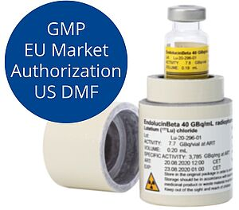

LU-177 n.c.a
No-carrier-added Lutetium
^{Highest specific activity >}
No long-lived radioactive impurities Highest radionuclide purity Less than 10-5 % of 177mLu (under detection limit)
Highest Quality of n.c.a. 177 Lu offers best radiolabeling performance no waste disposal problem Longer shelf-life up to 2 weeks.
No-carrier-added
^{176Yb(n,γ)177Yb →}
^{177Lu}
Hf 176
5.206
Hf 177
18.60
Lu 175
97.41
σ 8
Lu 176
2.59
σ 3 + 2070
Lu 177
_{160.1 d} ^{6.647d}
β^{- β-}
Yb 177
1.9 h
β
Yb 174
31.8
σ 68
Yb 175
4.2 d
β
Yb 176
12.7
σ 3

Slide 31
ACTINIUM-225
225Ac is delivered in 2 mL V-shape vial as a solution in 0.1 M hydrochloric acid
Volume: 0.1 mL (can be adjusted)
Physical half-life: 10 days
Number of Alpha particles in total: 4
Energy (α): 5.9, 6.5, 7.2 und 8.5 MeV
Nuclide manufacturing/origin: 229Th/225Ac generator with subsequent purification of 225Ac
Chemical purity: > 99.9 % 225Ac
Intended use: Labelling of peptide precursors like :
- DOTA-TOC for Neuroendocrine tumors
- ITG-PSMA-1 for prostate cancer treatment
- DOTA-Zoledronic acid for bone Metastasis

Slide 32
PEPTIDES-LU177&Y90
DOTATATE AA 0.1 mg kit for direct radiolabelling (with ascorbic acid)
Code: DOT-01
Composition: DOTATATE trifluoroacetate: 0.1 mg/vial
Ascorbic acid: 50 mg/vial
NaOH: 7.9 mg/vial
Primary packaging: 2 mL glass vial sealed with rubber closure and flip-off cap
Storage conditions: 2-8oC
Shelf life: 12 months
Features: sterile, endotoxin free, freeze-dried solid
Purpose: for direct preparation of 90Y or 177Lu-DOTATATE without necessity of purification step. Radiolabeling efficiency > 98%.
Maximum radioactivity of 177Lu, which can be added to the kit vial depends on its specific activity (SA);
for example using 177Lu of SA 500 GBq/mg it is not more than 2.9 GBq. For more information please contact us.
DOTATATE AA 0.25 mg kit for direct radiolabelling (with ascorbic acid)
Code: DOT-02
Composition: DOTATATE trifluoroacetate: 0.25 mg/vial
Ascorbic acid: 50 mg/vial
NaOH: 7.9 mg/vial
Primary packaging: 2 mL glass vial sealed with rubber closure and flip-off cap
Storage conditions: 2-8oC
Shelf life: 12 months
Features: sterile, endotoxin free, freeze-dried solid
Purpose: for direct preparation of 90Y or 177Lu-DOTATATE without necessity of purification step. Radiolabelling efficiency > 98%.
Maximum radioactivity of 177Lu, which can be added to the kit vial depends on its specific activity (SA);
for example using 177Lu of SA 500 GBq/mg it is not more than 7.4 GBq. For more information please contact us.

Slide 33
PEPTIDES-LU177&Y90
PSMA-D4 100 μg
Code: PMA-04
Composition: PSMA-D4 – 100 μg/via
Primary
packaging: 2.5 mL glass vial sealed with rubber closure and flip-off cap
Storage: -20 +/- 5C
Expiry date: 12 months
Features: sterile, endotoxin free, freeze-dried solid
Purpose: for 177Lu labelling in accordance with procedure of labelling issued by POLATOM
OTHER OFFERING:
Imaging & Calibration Sources (ERS)
Flood Sources
Dose Calibrator Sources
Spot Markers
Rod Sources

